Slide 1

Strengthening universities and their service to society through values – how the Magna Charta Observatory can help.

Slide 2
Agenda
Introduction
MCU 2020
Living Values
Student Engagement
Closing remarks
Questions and discussion

Slide 3
Introduction
David Lock
Secretary General
1988 Origin
2000 Observatory Established
Proactive and reactive engagement
Observatory and aid to universities
Living Values Project
MCU 2020

Slide 4
1988 Fundamental Principles
The university is an autonomous institution which produces, examines, appraises and hands down culture by research and teaching.
Its research and teaching must be morally and intellectually independent of all political authority and economic power.
Teaching and research must be inseparable if tuition is not to lag behind changing needs, the demands of society, and advances in scientific knowledge.

Slide 5
1988 Fundamental principles 2
4. Freedom in research and training is the fundamental principle of university life, and governments and universities must ensure respect for this fundamental requirement.
5. A university ….should attain universal knowledge; …..transcend geographical and political frontiers, affirms the vital need for different cultures to know and influence each other.

Slide 6
Speakers
Professor Marta Losada
Professor Marcelo Knobel
Tamires Gomes Sampaio

Slide 7
Professor Marta Losada

Slide 8
MCU 2020
Motivations to modify MCU:
  Much has changed since 1988.
  Higher education is more international.
  The Observatory is operating in a more global way.
  Other values are becoming important.
  A series of workshops around the world has resulted in evidence which suggests that the MCU is now out of date, incomplete, too narrow in focus, restricted to a Humboldtian conception of a university and can be improved in other ways.

Slide 9
MCU 2020
Review Committee Members
  Dr Sijbolt Noorda, President of the MCO Council, President Emeritus of the University of Amsterdam
  Dr. Patrick Deane, President and Vice-Chancellor McMaster University, Canada; now President Queens University, Canada
  Tamires Gomes Sampaio, Formerly UNE - National Union of Students, Brazil
  Eva Egron Polak, Former SG of IAU, France, Member of MCO Council, Italy
  Professor Chanita Rukspollmuang PhD Assistant President Siam University, Thailand
  Professor Narend Baijnath, CEO of the Council on Higher Education in South Africa
  Dr. Marta Losada Falk, President Emeritus Antonio Narino University, Colombia
  Professor Francesco Ubertini, Rector of the University of Bologna, Italy

Slide 10
MCU 2020
Goals of review:
  address societal issues,
  sustainability and the
  responsibilities of universities to society through values that are relevant for the future.
  It wants to facilitate a wide and global discussion on the issues and the adequacy of MCU 2.0 in responding to them.
Presentations:
CAEI 2019, MCU Conference, etc
Approved by the Governing Council 12 March 2020

Slide 11
MCU 2020
Preamble
  a declaration and affirmation of the fundamental principles upon which the mission of universities should be based, signed in 1988
    Independence: research and teaching must be intellectually and morally independent of all political influence and economic interests
    Teaching and research should be inseparable: with students engaged in the search for knowledge and greater understanding
    University as a site for free enquiry and debate, distinguished by its openness to dialogue and rejection of intolerance
  recognised that universities upholding these principles could take many forms under the combined influence of culture, geography and history.
  envisaged a networked world in which knowledge and influence should cross cultural boundaries in the pursuit of human understanding

Slide 12
MCU 2020
Preamble
  The world has since become interconnected in ways unimaginable at the time of the original declaration. Universities have proliferated around the globe, dramatically increasing in variety as well as scope and mission. Globally the number and diversity of students seeking a university education has increased, as have their reasons for doing so and the expectations of their families and communities. The number of publications has increased enormously while trust in academia is being eroded by a loss of confidence in expertise. In the sway of new technologies, modes of learning, teaching and research are changing rapidly; universities are both leading and responding to these developments.
  Despite these changes, the potential of higher education to be a positive agent of change and social transformation endures.
  Principles laid out in MCU are as valid today as they were in 1988, and they are the necessary precondition for human advancement through enquiry, analysis and sound action
  require the global academy to identify responsibilities and commitments that the signatories agree are vital to universities around the world in the Twenty-First Century. That is the reason for this new declaration.

Slide 13
MCU 2020
Principles, Values and Responsibilities
  Universities acknowledge that they have a responsibility to engage with and respond to the aspirations and challenges of the world and to the communities they serve, to benefit humanity and contribute to sustainability.
  Intellectual and moral autonomy is the hallmark of any university and a precondition for the fulfilment of its responsibilities to society. That independence needs to be recognised and protected by governments and society at large, and defended vigorously by institutions themselves.
  To fulfil their potential, universities require a reliable social contract with civil society, one which supports pursuit of the highest possible quality of academic work, with full respect for institutional autonomy.
  As they create and disseminate knowledge, universities question dogmas and established doctrines and encourage critical thinking in all students and scholars. Academic freedom is their lifeblood; open enquiry and dialogue their nourishment.
  Universities embrace their duty to teach and undertake research ethically and with integrity, producing reliable, trustworthy and accessible results.

Slide 14
MCU 2020
Principles, Values and Responsibilities
  Universities have a civic role and responsibility. They are part of global, collegial networks of scientific enquiry and scholarship, building on shared bodies of knowledge and contributing to their further development. They also are embedded in local cultures and crucially relevant to their future and enrichment. While they are immersed in and connected with global developments, they engage fully with and assume leading roles in local communities and ecosystems.
  Universities are non-discriminatory spaces of tolerance and respect where diversity of perspectives flourishes and where inclusivity, anchored in principles of equity and fairness, prevails. They therefore commit themselves to advance equity and fairness in all aspects of academic life including admissions, hiring and promotion practices.
  Education is a human right, a public good, and should be available to all. Universities recognise that learning is a lifelong activity with tertiary education as one part of a continuum. Within that one part, universities serve diverse learners at all stages of their lives.

Slide 15
MCU 2020
Universities acknowledge that individuals and communities, often due to inequitable circumstances, have difficulty gaining access to higher education or influencing the modes and matter of academic study. To realise human potential everywhere, universities deliberately seek ways to welcome and engage with diverse voices and perspectives.
By signing the Magna Charta Universitatum 2020 universities declare their commitment to the original declaration and to upholding and advancing the Principles, Values and Responsibilities stated above, to strengthen the role of universities in promoting health, prosperity and enlightenment around the world.

Slide 16
Professor Marcelo Knobel

Slide 17


Living values project at Unicamp
The values that were identified as being relevant, the reasons why and implications for the University
Marcelo Knobel
Brazil

Slide 18
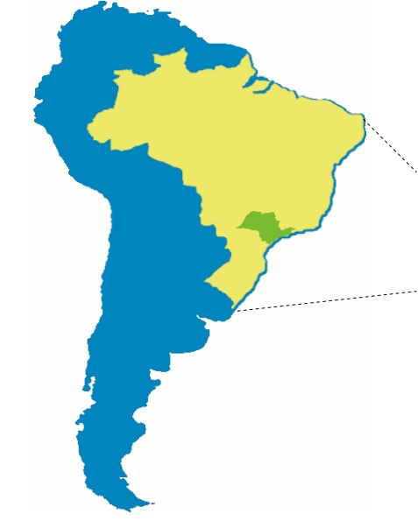
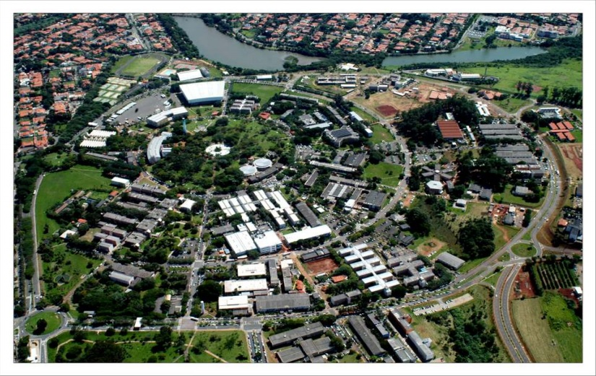
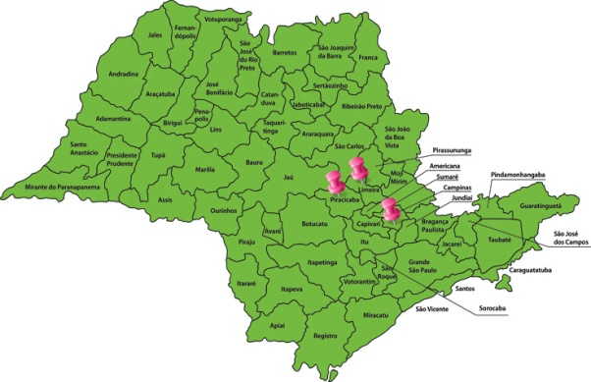
University of Campinas
Public, state funded, tuition free
http://siplanes.unicamp.br/planes/PlanejamentoEstrategico/ApresGeralEmIn.pdf

Slide 19
Facts & Figures
Some numbers that best describe UNICAMP (2017)
http://www.internationaloffice.unicamp.br/english/international-visitors/the-university/facts-figures/
UNDERGRADUATE
Academic Programs
70
Total Students
18,338
Diplomas Awarded
2,249
GRADUATE
Academic Programs
156
Master: 74 | Doctorate: 68 | Specialization: 14
Students
16,195
Master: 5,263 | Doctorate: 6,141 | Specialization: 1,425 | Special Enrollments: 3,366
Thesis
2,546
Master: 1,310 | Doctorate: 946 | Specialization: 290

Slide 20
Facts & Figures
Some numbers that best describe UNICAMP
HUMAN RESOURCES
http://www.internationaloffice.unicamp.br/english/international-visitors/the-university/facts-figures/
Faculty
1,759
Faculty with Doctorate Degree
99%
Non-Faculty
8,254

Slide 21
The Living Values
Project at Unicamp
Project Objectives: investigate and discuss
1. The values shared by our community
2. The values that we must incorporate, and
3. The expectations of the society that supports Unicamp

Slide 22
Steps
What we did
Prepared a reference document with definition of consensus concepts by the project management group, aligned with strategic planning and other institutional reports.
2. Workshop for validation of values and definitions & perception of values experienced at Unicamp (May 26, 2018) - Unicamp Administration and students.
3. Alignment with Unicamp Strategic Planning cycle.

Slide 23
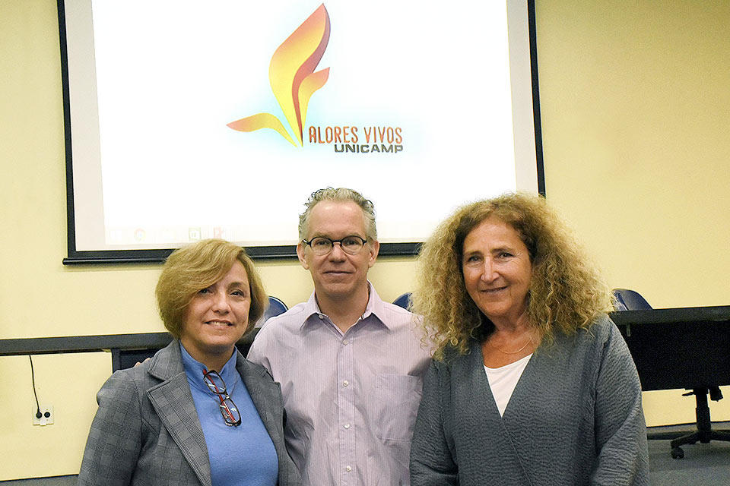
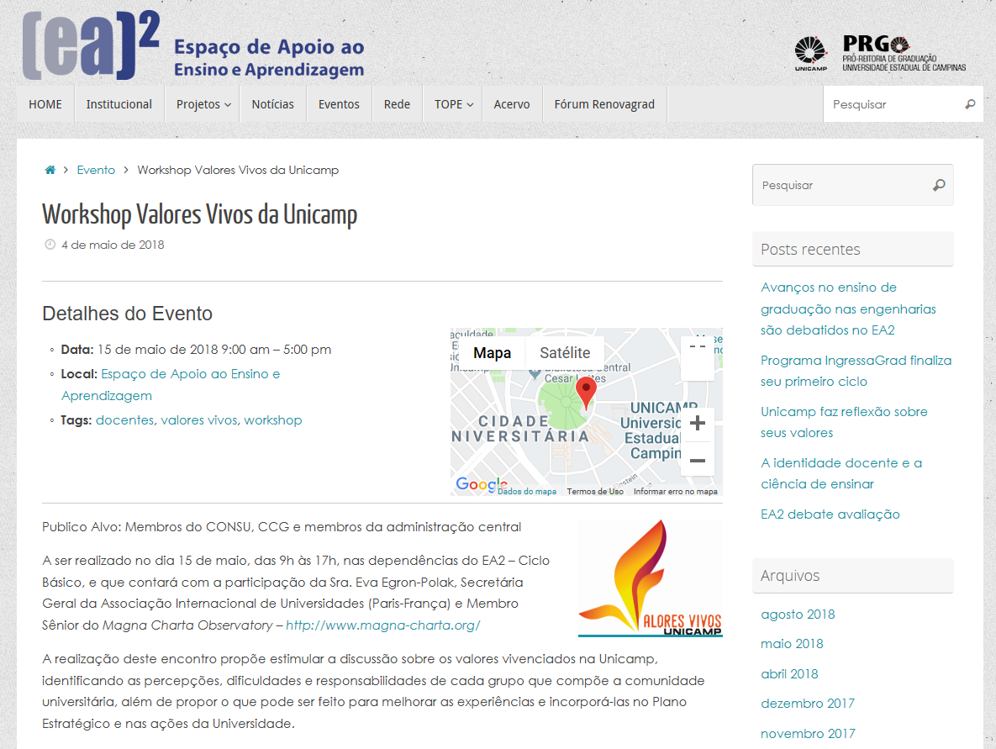
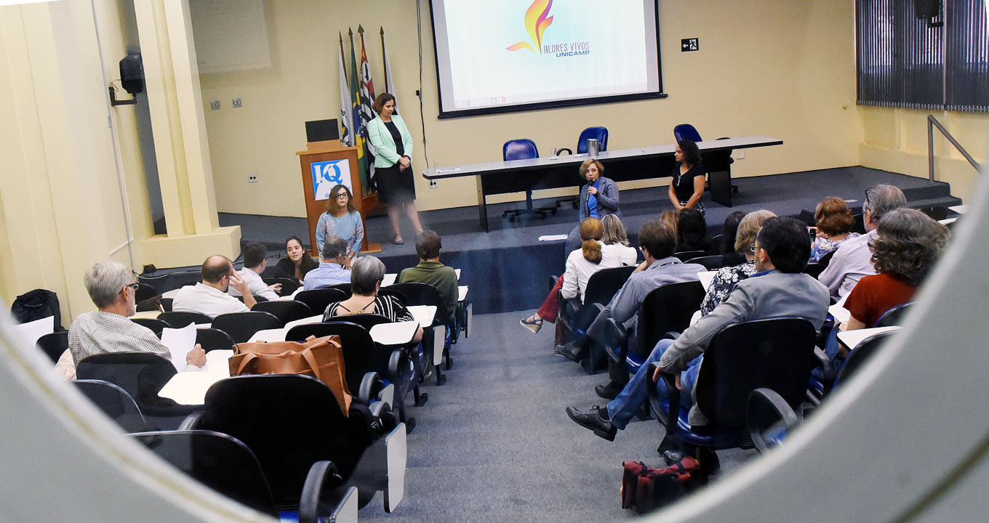
https://www.ea2.unicamp.br/events/event/workshop-valores-vivos-da-unicamp/

Slide 24
Workshop dynamics
The participants discussed initially:
The extent to which the original core values (Institutional autonomy; Academic freedom) of the Magna Charta Universitatum are still relevant after three decades
What new values are relevant to be added to the list, including the ones that are unique or especially important at Unicamp

Slide 25
Values by priority order

Slide 26
Workshop Development
Later, the participants were assembled in small groups:
Is this a value lived at Unicamp? What is the evidence that this is a living value at Unicamp?
What are the successful experiences at Unicamp in relation to this value?
What are the difficulties in living or incorporating this value?
What actions should be taken to reduce or remove these difficulties?

Slide 27
New list of values
Social responsibility: commitment to the understanding of the problems of society and search for solutions that can improve the life of communities.
Institutional autonomy: self-management characteristic related to internal organization and governance, personnel recruitment, internal distribution of financial resources and raising of financial resources from non-public sources, and personnel recruitment in order for the University to fulfill its mission with social responsibility and in accordance with its values.
Accountability: duty of reporting, explaining and justifying, to society and to itself, the taking of decisions, use of resources and results achieved, with administrative and financial transparency.
Academic freedom: freedom to develop activities within a community-determined structure respecting ethical principles and best practices, within the legal frameworks.
Academic rigor and excellence: permanent search for higher levels of performance in all academic activities (research, teaching, innovation, extension and assistance), with sound theoretical basis, ethical integrity and scientific rigor.

Slide 28
New list of values
Academic rigor and excellence: permanent search for higher levels of performance in all academic activities (research, teaching, innovation, extension and assistance), with sound theoretical basis, ethical integrity and scientific rigor.
Sustainability: prioritization of activities that are ecologically correct, socially fair, economically viable and sensitive to the local culture considering the potential impact on the quality of life of future generations.
Inclusive excellence: commitment to the development of citizens who understand the world in its wideness and their place in it, promoting the social and intellectual development of the community, and valuing the cultural differences brought to the institutional experience, which improves it.

Slide 29
New list of values
Equity and diversity: commitment to the promotion of opportunities to bring the conditions between people and groups closer together considering the socioeconomic and cultural context, which includes aspects of gender, ethnicity, age, religion, sexual orientation and physical, mental, intellectual and sensorial disabilities, to ensure impartiality and fairness in the institutional processes. It includes demand for strategies for the student population to represent the diversity of society.
Integrity: honesty, absence of corruption in any field, dignity, recognition of personal responsibility and transparency.
Creativity: use of original ideas or improvement of ideas to promote technological, cultural and artistic innovation as well as entrepreneurship in the fields of teaching, research and extension.
Future vision / Looking ahead: attention to emerging and future issues regarding the fulfillment of the academic mission.
Institutional commitment: priority commitment to the institution’s collectively defined principles, values, mission and strategy

Slide 30
Why were these values
considered relevant?
They reflect:
Our context as public, and free-of-charge
Our condition as autonomous, supported by a proportion of taxes (goods) from the state (majority) + research projects
The institutional culture, as research-oriented (top patent producer in Brazil), innovative, focusing on entrepreneurship, and also inclusive and socially-oriented.

Slide 31
Implications for Unicamp
Having the new list of values validated by a group of University leaders aligned with other important discussions/projects, providing a robust platform for institutional mission and development:
  Diversity, Access, Inclusion and Success
  Human Rights Observatory, Refugees Chair
  Sustainable Development Goals (SDGs) as a framework for curriculum and institution planning
Initially, the discussion of values was seeing in competition with/parallel to the institutional evaluation process under way (2014-2019), to support strategic planning (2020-2024). The leading team has been able to clarify the importance of the VV project as supportive of the strategic planning cycle.
Survey on the perception of university community (faculty, students, staff) about these values was agreed to be postponed to mid-end 2019, after the bottom-up institutional self-evaluation (from academic units to central administration) has taken place.

Slide 32
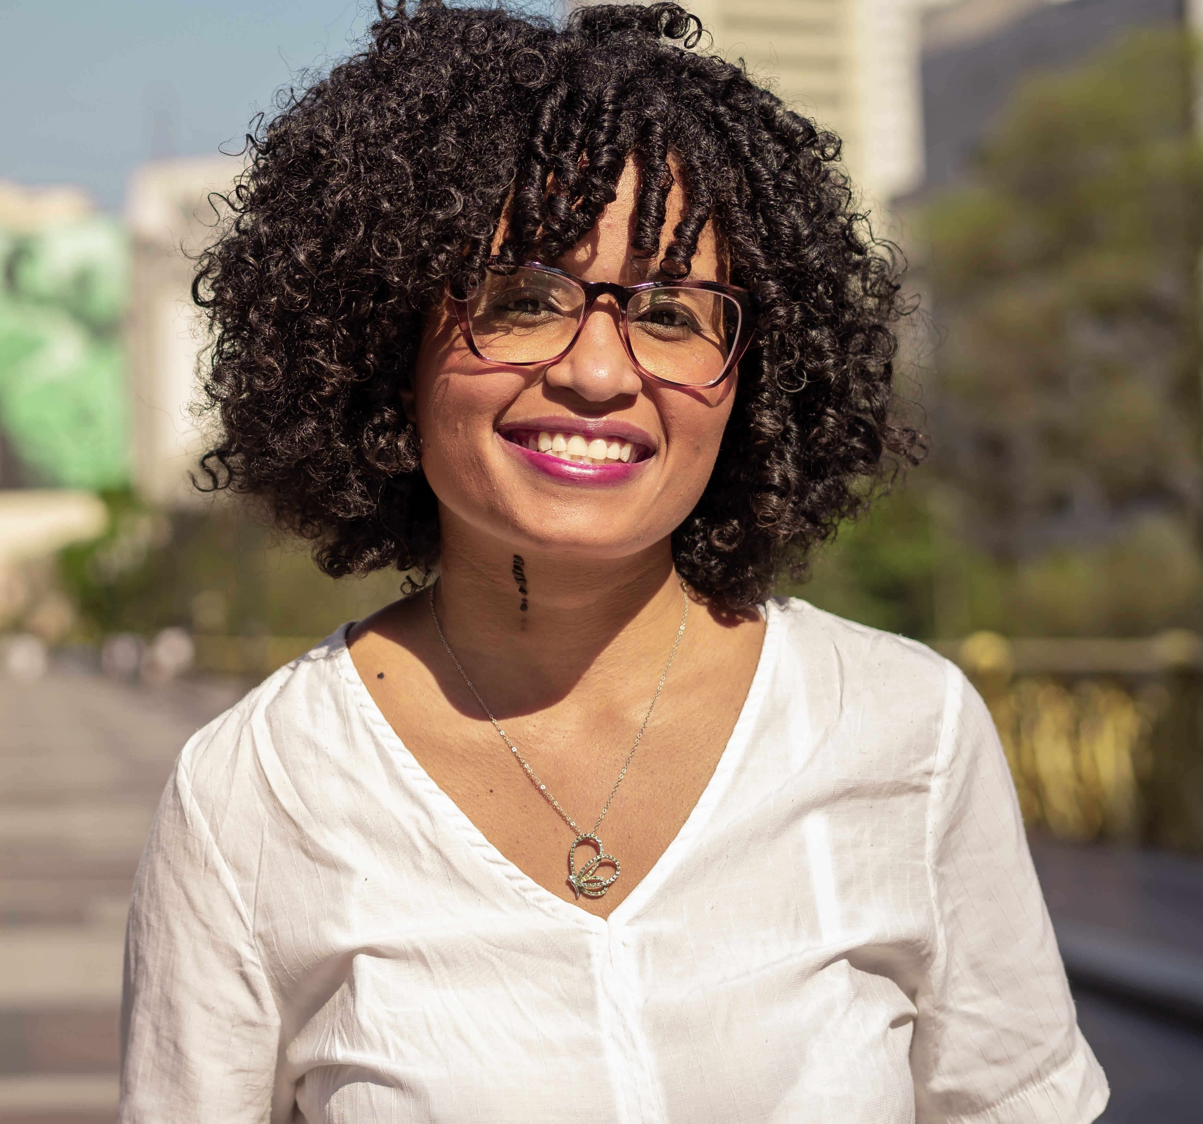
Tamires Gomes Sampaio
is a lawyer, master in Political and Economic Law. She was president of the Law Students Union of Mackenzie Presbiterian University (2014-2015) and vice president of the National Union of Students of Brazil (UNE) during 2015 to 2017. She participated in the Global Student Voice seminar in Norway in 2016 representing UNE and was one of the student leaders who wrote the Bergen Declaration.
She was the student representative of the drafting group of Magna Charta Universitatum 2020.

Slide 33
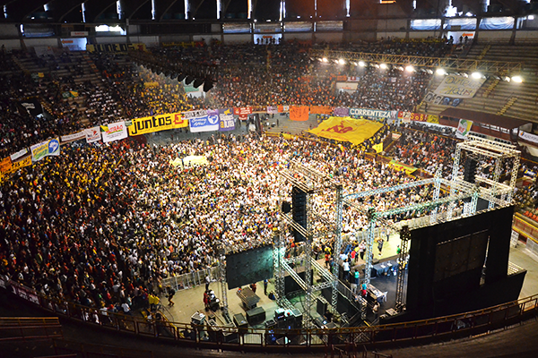
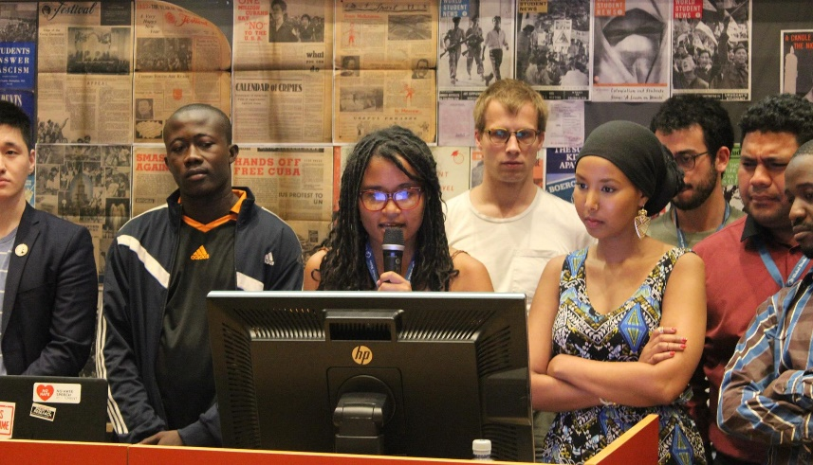
What the new MCU means for students?
final plenary of the UNE national congress 2017
Reading of the Bergen Declaration in 2016 (Norway)

Slide 34
Bergen Declaration
The Bergen Declaration was drafted and agreed on by the participating National students unions from all over the World during the Global Student Voice seminar in Bergen. The Declaration was drafted by student representatives from South America, North America, Europe, Africa, Asia, and the Pacific in May 2016.

Slide 35
Bergen Declaration
Uniting for a global student voice
Education is a Human Right
Students’ rights (quality education, students organization, autonomy, etc)
Access to tertiary education (education should be a public and universal good)
Sustainability, Mobility and Safety
Global Students Voice (Global Student Forum)

Slide 36
MCU 1988 and Students
“Each university must – with due allowance for particular circumstances – ensure that it’s students’ freedoms are safeguarded, and that THEY enjoy consessions in which They can acquire the culture and training which it is their purpose to possess.”
- MCU 1988

Slide 37
MCU 2020 and students
“The Magna Charta Universitatum, a declaration and affirmation of the fundamental principles upon which the mission of universities should be based, was signed in 1988 on the occasion of the 900th anniversary of the University of Bologna.”
Here in Brazil, we learned that the tripod that provide the basis for higher education is teaching, research and extension. When we talk about the principles being implemented I would say that there is another tripod: the direction, the professors and the students.

Slide 38
MCU 2020 and students
Worldwide, the student movement calls for greater student participation in the direction of universities and when we include students in MCU 2020 we are recognizing them as a fundamental part of implementing these principles.

Slide 39
MCU 2020 and students
“The second was that teaching and research should be inseparable, with students engaged in the search for knowledge and greater understanding.”
“Globally the number and diversity of students seeking a university education has increased, as have their reasons for doing so and the expectations of their families and communities.”
“As they create and disseminate knowledge, universities question dogmas and established doctrines and encourage critical thinking in all students and scholars. Academic freedom is their lifeblood; open enquiry and dialogue their nourishment.”

Slide 40
MCU 2020 and students
“Universities are non-discriminatory spaces of tolerance and respect where diversity of perspectives flourishes and where inclusivity, anchored in principles of equity and fairness, prevails. They therefore commit themselves to advance equity and fairness in all aspects of academic life including admissions, hiring and promotion practices.”
“Education is a human right, a public good, and should be available to all. Universities recognise that learning is a lifelong activity with tertiary education as one part of a continuum. Within that one part, universities serve diverse learners at all stages of their lives.”

Slide 41
What the new MCU means for students?
a recognition that we are part of the university not only as passive subjects, but as active actors who are part of the construction and implementation of the principles that MCU defends.

Slide 42
Thank you
Tamires Gomes Sampaio
E-mail: tamylpdf@gmail.com
@soutamires.sp

Slide 43
Signing the MCU
http://www.magna-charta.org/magna-charta-universitatum/sign-the-magna-charta
Benefits of signing
Public statement of values resulting in
  Publicity
  Confidence in integrity
  Confidence for partnership
Membership of and support from an international community concerned with fundamental values
Keeping commitment fresh through review
Learning from engagement with MCO
Reputational benefit

Slide 44
How to become a signatory
Via website http://www.magna-charta.org
Admissions policy
Complete application
Obtain Supporting information
Submission by due date
Consideration by Applications Committee
Decision by Council
Participation in Signing Ceremony
Publicity and engagement

Slide 45
Questions and Discussion

Slide 46
Contact details
More information available from
www.magna-charta.org
Contact via
magnacharta@unibo.it

